Slide 1
Suspicious Activity Detection in Hospital
1. Kharmate Mayur Sambhaji
2. Uttekar Aniket Rajesh
3. Kulkarni Shreyas Ajay
4. Desai Kunal Anil
Guided by:
Prof. Deepali Dagale

Slide 2
Agenda
1.Aim
2.Liturature Survey
3.Motivation
4.Objectives
5.Proposed System
6.H/W and S/W to be used
7.Social Aspect
7.Conclusion
8.References

Slide 3
Aim
Security has been a key feature in the present world due to an increase in the
unethical activities or anti-social activities that have been happening very frequently . Many organizations have installed CCTV for constant monitoring of people and their movements, interactions. A lot of video data is generated continuously. Constant monitoring of data by humans to judge if events are abnormal is an impossible task as it requires a workforce and constant attention. This creates a need for automating the same . Also, there is a need to observe in which frame and which parts of it contain the unusual activity which gives the fast judgment of that unusual activity being abnormal. This can be done by converting video into frames and analyzing the people and their activities from the processed frames.

Slide 4
Literature Survey
Sr. No. | Title of Paper | Year | Author | Key Points | Limitations
1 | Multimedia Tools Applications | 2016 | Nam Y | Real-time abandoned and stolen object detection based on spatio-temporal features in crowded scenes | Multimedia requires electricity to be operated. Creating multimedia requires more time.
2 | Trans Circuit System Video Technology | 2015 | Dimitropoulos K, Barmpoutis P, Grammalidis N | Proposed a method for real time fire detection to model behaviour of fire by using spatio-temporal features like color probability, spatio temporal energy, flickering. | User Have Knowledge About languages and hardware ,Software

Slide 5
Sr. No. | Title of Paper | Year | Authors | Key Points | Limitations
3 | Robust abnormal event recognition via motion and shape analysis at ATM installations | 2015 | Tripathi V, Gangodkar D, Latta V, Mittal A | For reducing dimensions PCA was used and for classification SVM was used.
4 | Computer Vision and Image Understanding | 2012 | Wiliem A, Madasu V, Boles W, Yarlagadda P | A suspicious behaviour detection using a context space model for smart surveillance systems. | Time Consuming

Slide 6
Sr. No. | Title of Paper | Year | Authors | Key Points | Limitations
5 | Smart Security System for Suspicious Activity Detection in Volatile Areas | 2020 | Joy Iong Zong Chen | Smart Security, Suspicious Activity, Volatile Areas, Motion Sensors, Facial Identification | Device Using High Internet. It is not Live recording utilizing
6 | Sensor-Based Abnormal Human-Activity Detection | 2008 | Jie Yin, Qiang Yang | Activity recognition, outlier detection, sensor networks, data mining. | Cost Sensitive In Nature , Data are inherently unbalanced
7 | SUSPICIOUS ACTIVITIES DETECTION USING VIDEO ANALYSIS | 2021 | 1P. Rajasekhar Reddy,2B. Nirupa, 3Preetham Kumar, 4S. Vaishnavi | Security, automate, machine learning, deep learning. | All Particular Versions Installation Required Need High Internet Connection

Slide 7
Sr. No. | Title of Paper | Year | Authors | Key Points | Limitations
8 | Suspicious human activity recognition: a review | 2018 | Rajesh Kumar | Abandoned object ·Theft detection ·Fall detection ·Accidents ·Violence · Fire detection | To develop an intelligent video surveillance system for the automatic recognition of suspi- cious human activities; there are various issues
9 | IoT based Remote Patient Health Monitoring System | 2010 | Narasimha Rao Jasti Madhu | Remote , Health Monitoring | The scope of the project was limited to ECG, fall, temperature, humidity, pressure, toxic gas, air quality and SPO2 detection and remote viewing of the collected data for a single patient.

Slide 8
Sr. No | Title of Paper | Year | Authors | Key Points | Limitations
10 | Vision-Based Detection of Unusual Patient Activity |  | Paulo Vinicius Koerich Borges | Patient Monitoring, Computer Vision | dataset such that a more thorough statistical
11 | Activity Monitoring and Unusual Activity Detection for Elderly Homes | 2020 | Liz George M | Activities of Daily Living (ADL), Support Vector Machine (SVM), Red Green Blue (RGB), Hidden Markov Models (HMM), Sensor of Movements (SoM), | Many improvements of this new approach are possible. Anomaly detection is an active area of current machine learning and data mining research. A
12 | Human Activity Recognition using Computer Vision based Approach – Various Techniques | 2020 | Prarthana T V1, Dr. B G Prasad2 | Human Activity Recognition, HAR, Deep learning, Computer vision | Concurrent activities are activities Not performed by one or multiple individuals at the same time.

Slide 9
Sr. No | Title of Paper | Year | Authors | Key Points | Limitations
13 | A Vision-Based System for In-Bed Posture Tracking | 2015 | Shuangjun Liu and Sarah Ostadabbas | Vrsion Based System,Bed Posture Traking | Need to video capturing devices and under different lighting
14 | Suspicious human activity recognition and alarming system using cnn and lstm algorithm | 2012 | Dr. Keerthika V[1],A Abhiram[2], | Activity Recognition , Deep Learnign | Its not real-time automated machine
15 | Vision‑based patient wellness monitoring using facial cues | 2017 | Sathyanarayana, Supriya | Engineering::Computer science and engineering::Computing methodologies::Image processing and computer vision | Some viewing angles may be more or less useful than others depending on the captured images.

Slide 10
Motivations
In hospital we are using CCTV monitored by humans for security purpose. But this is not a great idea, as many mistakes can take place by negligence or carelessness behavior of humans. Machines are better at identifying patterns, doing calculations & other things. We can Models and train them to do the same work. Machines are better at doing repetitive tasks. We can use machines in daily life for doing repetitive tasks as well as tasks that involve the lives of many people directly or indirectly such as Security. Surveillance and Suspicious Activity Detection in Hospital can be done manually as well as with machines using Video Surveillance. Machines with the help of Humans can be a better partner to solve most of our major security concerns in the hospital.

Slide 11
Objectives
1. Suspicious activity tracking will help in Enhancing the Security at Hospital .
2. It will help in tracking and detecting any suspicious person while he is doing any suspicious activity like destroying anything or harming someone .
3. It can also inform the Doctors or nurses that any harm has happened to the patient like if a patient wants to wake and there is no one around and he fells down .
4. During accidental emergency the security is at its lowest at that unauthorized people can also sneak into the hospital with malicious intent so we can detect such people easily .
5. If the patient is alone in his room and any person tries to harm the patient the authorised personal can be alerted .
6. If there is any fight is going on in the hospital it can easily be detected and alert can be sent to security team of hospital .

Slide 12
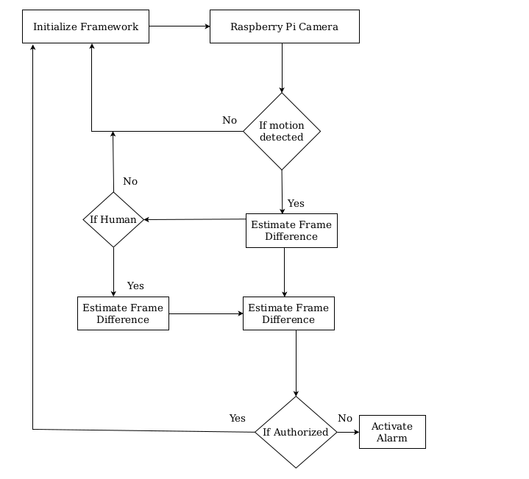
Proposed System

Slide 13
S/W to be used
Software Component | Details(Technical details with Purpose)
Operating System | Windows 7 and above
Technology | AI
Tool | Sublimetext3 and pycharm
Database | MySQL

Slide 14
H/W to be used
Hardware Component | Details(Technical details with Purpose)
Processor | Pentium IV , 2.4 GHZ
Memory | 220 GB
Network Interface | Standard Ethernet
Other (If Required) | 4 GB RAM

Slide 15

Planning & Scheduling of Project :

Slide 16
Social Aspect
This will make hospital more secure for the patients .
This project can help in making sure Elderly people at the home more secure when there in no one around to take care of them.
This can be used to make fire alarm more accurate .

Slide 17
Conclusion
Security could be a very serious concern nowadays and detecting unusual activities in public places in video surveillance requires the constant attention of some or the opposite person which is an impossible task. In the mentioned project, we have put forward a framework for a video analysis tool for suspicious event detection. This tool is designed to reduce the demanding task of manually sorting through hours of surveillance video sequentially to work out if suspicious activity has occurred. We discussed the ideas behind the assorted components of this framework in detail as well as a number of the implementation specifics.

Slide 18
References
1) Zelnik-Manor and M. Irani. Event-based analysis of video. In Proc. of the IEEE
Conf. on Computer Vision and Pattern Recognition, December 2001.
2) Y. Rui and P. Anandan. Segmenting visual actions based on spatiotemporal
motion patterns. In IEEE Conference on Computer Vision and Pattern Recognition,
June 2000.
3) J. Shi and J. Malik. Normalized cuts and image segmentation. In IEEE Conference
on Computer Vision and Pattern Recognition, San Juan, Puerto Rico, June 1997.
4) Li X, Zhang C, Zhang D (2010) Abandoned objects detection using double
illumination invariant foreground masks. In: 20th international conference on
pattern recognition (ICPR), 2010, IEEE, pp 436–439.
5) A. Mallikarjuna Reddy, V. Venkata Krishna, L. Sumalatha," Face Recognition
based on Cross Diagonal Complete Motif Matrix", International Journal of Image,
Graphics and Signal Processing(IJIGSP), Vol.10, No.3, pp. 59-66, 2018.DOI:
10.5815/ijigsp.2018.03.07.

Slide 19
6) Ayaluri MR, K. SR, Konda SR, Chidirala SR. 2021. Efficient steganalysis using
convolutional auto encoder network to ensure original image quality. PeerJ
Computer Science 7:e356 https://doi.org/10.7717/peerj-cs.356
7) A Mallikarjuna Reddy, VakulabharanamVenkata Krishna, LingamguntaSumalatha
and AvukuObulesh, “Age Classification Using Motif and Statistical Features
Derived On Gradient Facial Images”, Recent Advances in Computer Science and
Communications (2020) 13: 965.
https://doi.org/10.2174/2213275912666190417151247.
8) A. Mallikarjuna Reddy, V. Venkata Krishna, L. Sumalatha," Face recognition
based on stable uniform patterns” International Journal of Engineering &
Technology, Vol.7 ,No.(2),pp.626-634, 2018,doi: 10.14419/ijet.v7i2.9922
9) A. Mallikarjuna Reddy, V. Venkata Krishna, L. Sumalatha, “Efficient Face
Recognition by Compact Symmetric Elliptical Texture Matrix (CSETM)”, Jour of
Adv Research in Dynamical & Control Systems, Vol. 10, 4-Regular Issue, 2018.
10) A. M. Reddy, V. V. Krishna, L. Sumalatha and S. K. Niranjan, "Facial recognition
based on straight angle fuzzy texture unit matrix," 2017 International Conference
on Big Data Analytics and Computational Intelligence (ICBDAC), Chirala, 2017,
pp. 366-372, doi: 10.1109/ICBDACI.2017.8070865.

